Slide 1
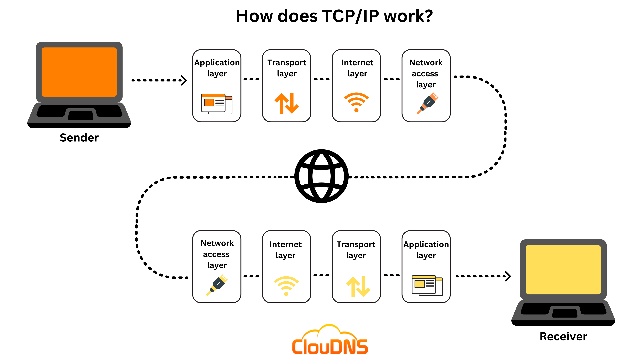
TCP IP Communication in Action Group Presentation
Scenario : Sending an Email
Presented by Mimi Aver Orngu (TL), ADELEKE OLUWAPELUMI FARUQ, Ahmad Sani Nana and Muhammad Abdulkudus
​

Slide 2
Presentation Objectives
By the end of this presentation, you will understand:
How an email travels from sender to recipient.
The TCP/IP layers and their functions.
Encapsulation and decapsulation.
IP and MAC addressing.
Port numbers and protocols involved.
Network devices used during communication.
Mapping TCP/IP to the OSI model.
Differences between TCP and UDP.
Troubleshooting a communication failure.

Slide 3
The TCP/IP layers and their functions.
TCP/IP model is a layered networking framework that explains how data is communicated between devices over a network using standardized protocols to ensure reliable and efficient transmission.
Layers of TCP/IP
Application Layer : This is the top layer, and it acts like a bridge between user applications and lower network layers. For example, web browsers, email clients, and file sharing tools interact with the network using protocols like HTTP, FTP, SMTP, and DNS.
Transport Layer : It ensures reliable and efficient delivery of data between devices, managing segmentation, ordering, and retransmission as needed.
Internet Layer : This is responsible for addressing, packaging, and routing data packets so they can travel across networks and reach the correct destination device. It assigns IP addresses and primarily uses IP with supporting protocols like and ICMP for error reporting and ARP for address resolution.
Network Access (Link Layer) : It physically transmits data over network hardware, including cables, switches, and wireless connections.

Slide 4
Email Communication Scenario
Scenario: Aisha send an email to Tolu
Sender: Aisha’s Laptop
Recipient: Tolu’s Laptop
Communication Path:
Aisha’s Laptop (Application(SMTP), Transport, internet layers, Network access)
Switch
Network Access Layer, Uses MAC Addresses
Router
Internet layer(IP),Network Access Layer, Uses IP Addresses
Tolu’s Laptop
Application layer (IMAP/POP3),Transport layer (TCP) Internet layer (IP),Network Access(Ethernet)
Mail Server
Application layer (SMTP),Transport layer, Internet layer, Network Access Layer,
Internet(Multiple Routers)
Internet layer(IP), Network Access Layer
Notes:
Alice composes an email and clicks Send. At the Application Layer, SMTP prepares the message for transmission. The Transport Layer uses TCP to establish a reliable connection and divide the email into segments. The Internet Layer adds source and destination IP addresses so routers can route the packets across networks. The Network Access Layer uses Ethernet or Wi-Fi to transmit frames across the local network. The switch forwards frames using MAC addresses, while routers forward packets using IP addresses. The email reaches the mail server, where it is processed and stored. Bob later retrieves the email using IMAP or POP3. The same TCP/IP layers are used throughout the communication process, and acknowledgement messages travel back to confirm successful delivery.

Slide 5
Communication Scenario Overview — Sending an Email
Scenario: A user clicks "Send" on a local desktop mail client (192.168.1.100), sending an email with a document attachment to mail.example.com (198.51.100.25)
Core Requirements:
Resolving the mail server hostname using DNS and A record queries over UDP port 53.
Establishing a reliable connection via the TCP 3-way handshake on Submission Port.
Upgrading the cleartext connection to an encrypted channel via the SMTP STARTTLS command sequence.
Exchanging mail commands to transmit the email payload.
End-to-End Principle: The transport state (sequence tracking, positive acknowledgments, flow control) is maintained solely at the endpoints (Client Host and Mail Server), while intermediate routers perform stateless Layer 3 packet forwarding.

Slide 6
Mapping the TCP/IP Model to the OSI Model
TCP/IP Model Layer | Corresponding OSI Model Layers | Primary Function in Sending Email
Application | Application (7), Presentation (6), Session (5) | SMTP formatting, MIME encoding for attachments, TLS encryption.
Transport | Transport (4) | End-to-end connection, reliability, and segmentation (TCP).
Internet | Network (3) | Logical addressing (IP) and routing across networks.
Network Access | Data Link (2), Physical (1) | Physical addressing (MAC), framing, and bit transmission.

Slide 7
Encapsulation and decapsulation Mechanics
The email client generates the SMTP message (Application).
TCP adds a header specifying the source port and destination port 587, which is the standard for secure SMTP submission (Transport).
IP adds a header containing the sender's IP address and the outgoing mail server's IP address (Internet).
The network interface adds a MAC address header and a Frame Check Sequence trailer, creating a frame that is converted into electrical or radio signals."
For the decapsulation, the reverse of headers being stripped away as data moves up the stack at the mail server.

Slide 8
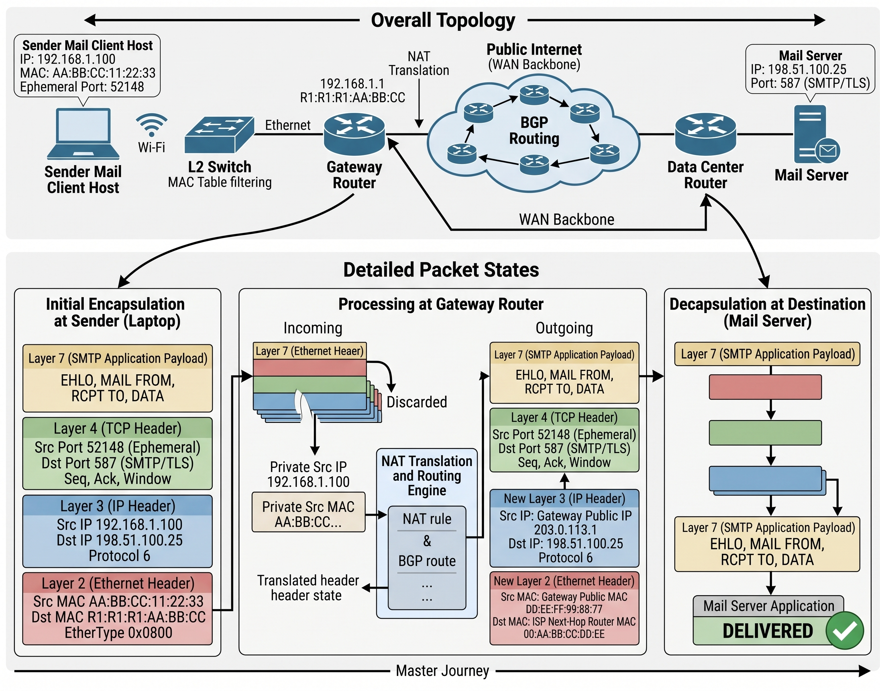
Original Packet Journey Diagram
Device Functions:
Switch (Layer 2): Inspects the Ethernet destination MAC address to forward frames to the correct physical port using its MAC address table.
Router (Layer 3): Strips the Layer 2 header, inspects the destination IP address, consults its routing table, rewrites source/destination MAC addresses for the next hop, and decrements the Time to Live (TTL) value.

Slide 9
Protocol Analysis Table.
TCP/IP Layer | Protocol | PDU (Data Unit) | Addressing | Purpose in Scenario
Application | SMTP / TLS | Data (Message) | Domain Name | Formats and securely transfers the outgoing email to the server.
Transport | TCP | Segment | Port Numbers | Ensures reliable, sequenced delivery of the email message.
Internet | IPv4 / IPv6 | Packet | IP Addresses | Routes the packet across the internet to the correct mail server.
Network Access | Ethernet / 802.11 | Frame | MAC Addresses | Delivers the frame to the next physical device on the local network.

Slide 10
TCP vs. UDP Comparison
Feature | TCP (Transmission Control Protocol) | UDP (User Datagram Protocol)
Connection Type | Connection-oriented (3-way handshake) | Connectionless (Fire and forget)
Reliability | Guaranteed delivery, error checking, retries | No guarantees, no retries
Speed / Overhead | Slower due to high overhead (acknowledgements) | Extremely fast, low overhead
Application Examples | 1. SMTP/IMAP (Email) 2. HTTPS (Web Browsing) | 1. VoIP / Online Meetings (Zoom) 2. DNS (Domain Name Resolution)
10

Slide 11
Communication Failure Analysis & Troubleshooting
Problem Statement: An employee attempts to send an email with an urgent report. The mail client hangs on "Connecting to outbound mail server..." for several minutes before failing with Error 0x800CCC0E: Connection to server timed out.
Root Cause Mechanism:
- An outbound firewall rule or ISP port block is dropping egress traffic on TCP Port 587 (or Port 25).
- When the mail client transmits its initial TCP SYN segment, the packet is silently discarded by the firewall filter.
- Because no SYN-ACK or RST is returned, the client's transport stack enters a Retransmission Timeout (RTO) loop.

Slide 12
Effective delivery techniques
Packet Capture Identification: Run Wireshark or tcp dump on the client host while attempting to send email.
Verify Layer 3 reachability vs. Layer 4 socket binding.

Slide 13
REFERENCES
TCP/IP Model – GeeksforGeeks
Recognized Networking Academy Text: Fall, K. R., & Stevens, W. R. (2011). TCP/IP Illustrated, Volume 1: The Protocols (2nd ed.). Addison-Wesley Professional
IETF Official Standard (TCP): Borman, D., Fairhurst, G., & Touati, A. (2022). Transmission Control Protocol (TCP). RFC 9293. IETF Datatracker
Wireshark Foundation (2026): "Wireshark User's Guide & Protocol Dissector Reference" URL: https://www.wireshark.org/docs/wsug_html/
IETF Specification RFC 5321 (2008): "Simple Mail Transfer Protocol (SMTP)" URL: https://intronetworks.cs.luc.edu/current/uhtml/tcpA.html

